Slide 1

State of Millbrae
water infrastructure
Study session III
April 11, 2017

Slide 2
DISCUSSION TONIGHT
Recap of sessions to date
Conclusions from last study session
Water Utility financial highlights
Revised water infrastructure replacement recommendation
Rate Proposal and Impacts
Next Steps

Slide 3
I. RECAP OF STUDY SESSIONS TO DATE
January 24: Status of the aged Water Utility infrastructure.
February 28: Answers to questions from the January 24 session, and four options for the future of the Water Utility, one of which was a phased-in rate increase.

Slide 4
II. CONCLUSIONS OF FEBRUARY 28 STUDY SESSION
The City Council was concerned that the initial recommendation on infrastructure funding was too risky:
- a 2% system replacement per year
would take 50 years to complete the entire system
- much of system has already reached it’s useful life.
- useful life of pipes = 50 years
- by year 50, significant portions of City would have pipes well over 50 years old.

Slide 5
CONCLUSIONS OF FEBRUARY 28 STUDY SESSION
The City Council asked for:
More information on the financial status of the Water Utility;
A revised recommendation on infrastructure replacement
Information on phasing in water rate increases over a multi-year period to adequately fund infrastructure needs over time

Slide 6
III. MILLBRAE WATER UTILITY FINANCIAL HIGHLIGHTS
The three most significant financial factors that have caused concern for Water Infrastructure:
176% water purchase cost increases from the SFPUC since 2009;
During that time, Millbrae’s last multi-year Water rate increases was for a phased in 29%.
Since last rate increase 7/1/13, revenues have decreased over 16% (due to conservation) .

Slide 7
MILLBRAE WATER UTILITY FINANCES ARE UNSUSTAINABILE
The result of these factors is that the Water Utility is running out of funds:
For the last three years, Water Utility has dipped into reserves by $3.1 million to fund ongoing operating costs (before any capital improvements were funded)

Slide 8
Water Utility Annual Net Operations and Draws on Reserves Since 2010 $’s expressed in 000’s

Slide 9
MILLBRAE WATER UTILITY FINANCIAL TRENDS, NOTE ON NEXT SLIDE:
Water Purchases have skyrocketed
O&M costs has been fairly static
Revenues have actually declined due to conservation…..

Slide 10
CITY OF MILLBRAE WATER UTILITY FINANCIAL HISTORY expressed in $’000’S

Slide 11
IV. REVISED INFRASTRUCTURE FUNDING PROPOSAL
Replace roughly 2.0-2.1 miles of pipe per year for a system with 75 miles of pipes total
Equates to 2.8% system replacement per year
With work done since 1995 (1/3 of system), the complete system replacement will occur in about 27 years
Roughly 80% would be replaced in about 20 years

Slide 12
INFRASTRUCTURE FUNDING PROPOSAL
This level of replacement will cost approximately $3.0 million annually

Slide 13
V. RATE IMPACT COMPARISONS

Slide 14
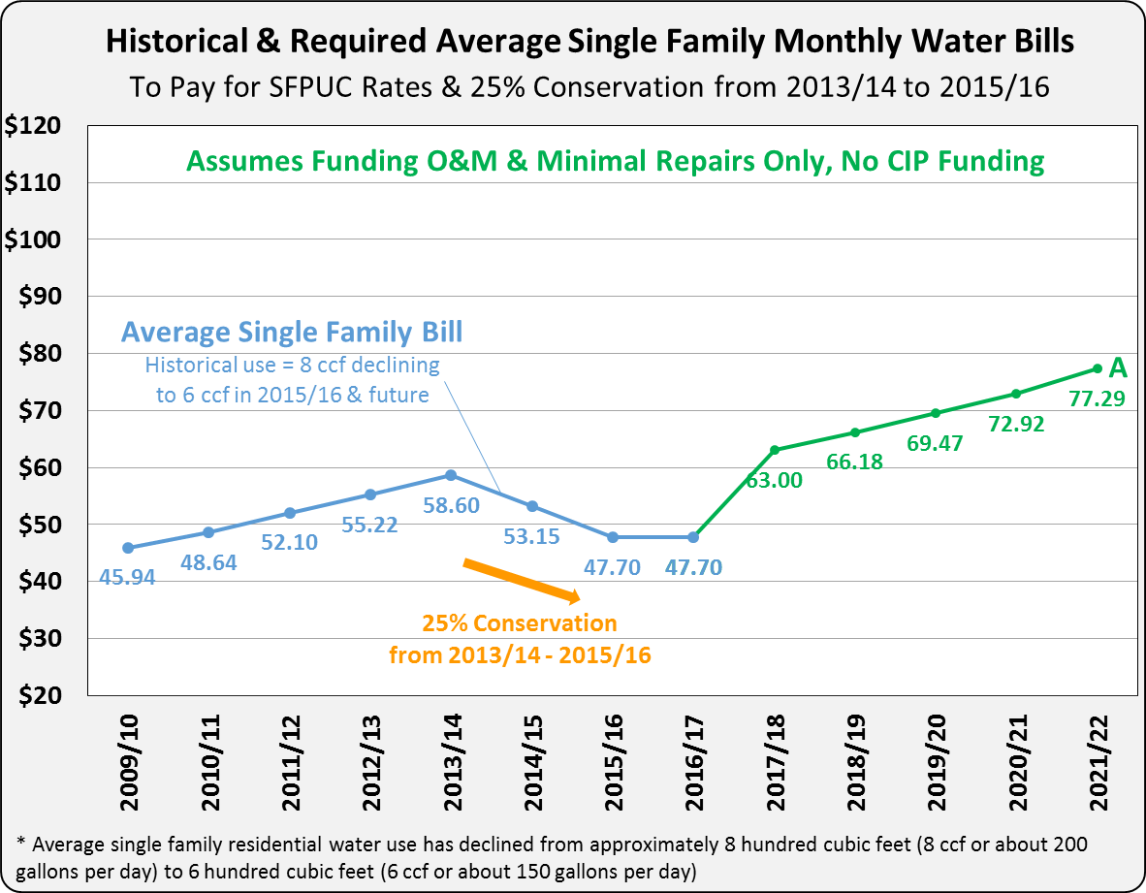

Slide 15
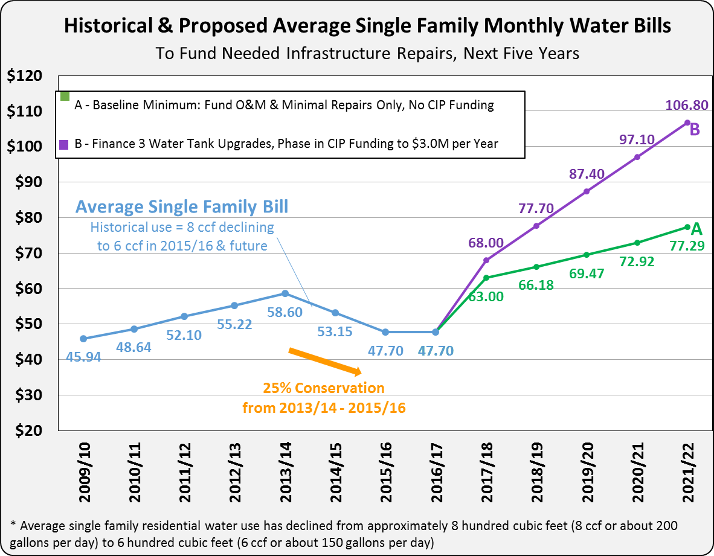

Slide 18
PROPOSED RATES WOULD BE THE MAXIMUM ALLOWED OVER 5 YEARS
If SFPUC or other costs came in lower, or if revenues bounced back after drought is over, rates could come in lower….

Slide 20
Notes:
Millbrae’s average home would pay $4.26/month more than the median (Redwood City)

Slide 23
MORE GRADUAL RATE INCREASE WOULDN’T ERASE FUND DEFICIT IN YEAR 1
Staff reviewed more even rate increases each year (15%-20% with a first year increase of up to 30%).
Those resulted in a depletion of reserves the first year, even with no emergency repairs funded in year 1.
First year increase is needed just to keep up with SFPUC costs and conservation impacts on revenue.

Slide 24
VI. NEXT STEPS
If the Water Utility is to avoid running out of funds, it is recommended that the Council direct staff to:
Prepare detailed information mailers to all water customers regarding the recommended 5-year phased (maximum) rate plan;
Return with those proposed maximum rates 45 days after mailing for formal consideration in a Proposition 218 compliant public hearing.
- First year rate increase would go into effect July 1, 2017

Slide 25

DISCUSSION/ Next Steps

